Slide 1
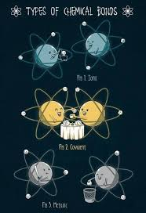
Chemical Bonding

Slide 2
A chemical bond is the attractive force between 2 atoms or ions – form molecules.
Chemical Bonds involve the rearrangement of valence electrons.
Atoms combine to form compounds – this changes their properties.
As chemical bonds form, atoms are brought to a lower energy state.

Slide 3
Potential Energy
Free (unbonded) atoms
high
Form
Bonds
Energy
Released
Break
Bonds
Energy
Absorbed
Bonded Atoms
low

Slide 4
Chemical Energy
The energy released as bonds form or the energy absorbed as bonds break
When 2 atoms bond they drop to a lower energy state – they are more stable.
The same amount of energy released when a bond forms must be added (absorbed) to break that bond.

Slide 5
Compounds formed in highly exothermic reactions tend to be more stable than compounds formed in endothermic or slightly exothermic reactions.
Release a lot of energy – need a lot of energy to break bond
Release a little energy – need little energy to break bond.

Slide 6
Bonds form because 2 atoms are fighting over valence electrons.
Essentially 2 atoms attract the same electrons at the same time.
Atoms need 8 valence electrons (stable octet)
Exceptions – H and He only need 2 to fill valence.
Bonds form between 2 atoms and only 2 atoms

Slide 7
Electronegativity(eneg)
The ability of an atom to attract an electron form another atom The atoms ability to pull electrons
Electronegativity Chart – devised by Linus Pauling
Based on a scale of 0 – 4
Fluorine has strongest attraction = 4.0
All others are compared relative to fluorine

Slide 8
Electronegativity Trend
Values in table S
As you move up and right in the periodic table, eneg increases (closer to fluorine).
Noble gasses have 0 electronegativity.
F

Slide 9
Which has higher eneg?
Cs or Se
Na or Cl
Mg or Na
In or O

Slide 10
Types of Chemical Bonds
Atoms form bonds to fill (stabilize) their valence shell.
Lose , Gain or Share e-

Slide 11
Ionic Bonds
Atoms transfer electrons to form ions.
One atom loses e- (metal)
The other atom gains e- (nonmetal)

Slide 12
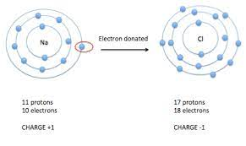
Na 11 +
11 –
Net charge 0
Eneg .9
Cl 17 +
17 –
Net Charge 0
Eneg 3.2

Slide 13
Ion
Charged particle due to gain or loss of electrons.
Cation – positive (+) charge due to loss of e-
Anion – negative (-) charge due to gain of e-
Are you positive you lost the cat
Ionic Bond – electrostatic attraction between opposite charged ions.
Form between metals and nonmetals
Difference ( )in electronegativity > 1.7.

Slide 14
Examples
Ion type how formed
K⁺
Ca⁺²
O⁻²
Br⁻

Slide 15
Ionic Compounds dot diagrams
KBr
CaO
K₂O
CaBr₂

Slide 16
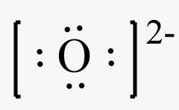
Lewis Structure for Ionic Compounds
Positive Ion –> all valence e- are removed – no dots are shown –> charge is written above the ion symbol.
Na⁺ Ca⁺²
Negative Ion – added e- make a full valence shell. Brackets are added and charge is written on outside.

Slide 17
Ionic Bonds Summary
Dot diagram requires Brackets and Charges
Very strong bond
High melting points and boiling points
Very rigid crystal structure (crystal lattice)
Form ionic solids (substances)
Results when eneg difference is greater than 1.7
Metal + Nonmetal

Slide 18
Draw Examples of dot structures
Ca
O
NaCl
SrS
Na₂O
CaF₂

Slide 19
Crystal Lattice Structure

Slide 20
Metallic Bonds
Form between 2 metals
Metals do not hold electrons very well
Low electronegativity and low ionization energy
They do not stay around any particular atom, they “float” from atom to atom
Referred to as a “sea of mobile electrons” or “delocalized electrons”
Mobility gives metals their properties

Slide 21
Sea of Mobile electrons

Slide 22
Covalent Bonds
2 nonmetals
Eneg difference between 0 and 1.7
Electrons are shared between valence shells
Weaker bonds than ionic
Covalently bonded atoms form molecules

Slide 23
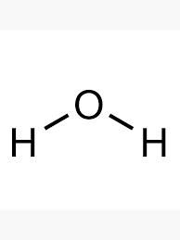
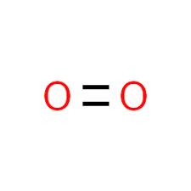
Structural Formula
Pairs of electrons are shown as a line or dash connecting the atoms.

Slide 24
Covalent Electron Dot Structures and Structural Formulas
H₂
Cl₂
O₂
N₂

Slide 25
H₂O
HBr
NH₃
CO₂
CH₄

Slide 26
Types of Covalent Bonds
1. Non polar (Not Different).
Eneg difference = 0
Occurs when 2 atoms have the same electronegativity
The electrons are shared equally
They spend equal amounts of time in each valence shell.

Slide 27
The Diatomic Molecules
Contain nonpolar covalent bonds
Diatomic – 2 atoms of the same element make a molecule
Hydrogen + the 7 that make a 7 starting at the bottom of group 17.
H₂ N₂ O₂ F₂ Cl₂ Br₂ I₂ At₂

Slide 28
2. Polar covalent bond (different)
Electronegativity greater than 0 but less than 1.7
Nonmetal atoms that have different electronegativity
Share electrons unevenly – one atom pulls more on the electrons
The electrons spend more time around one nucleus.
Unequal sharing of electrons

Slide 29
Examples
H₂O
HBr
CO₂

Slide 30
Molecules
Covalently bonded atoms form molecules
Molecules can be either polar or nonpolar
Remember: polar means different, nonpolar means not different!

Slide 31
Molecule Polarity
Polar bonds cause electrons to be pulled closer to one side of the molecule.
The side with the higher electronegativity gets a slight negative(-) charge
The side with the lower electronegativity gets a slightly positive (+) charge

Slide 32
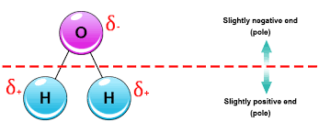
Polar Molecule
Can be divided into a positive (+) and a negative (-) side.
Caused by polar covalent bonds
+H Br-
Asymmetrical charge distribution
If you can draw one straight line and get all the + on one side and all the – on the other side the molecule is polar

Slide 33
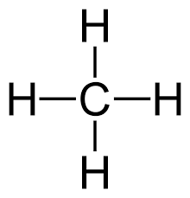
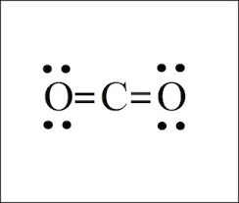
Nonpolar Molecules
Symmetrical charge distribution
All + and – charges are evenly distributed.

Slide 34
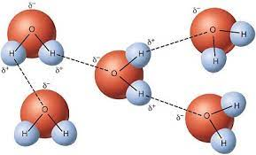
Molecule
Molecule – individual unit which can be separated from like units.
Covalent compounds form Molecules

Slide 35
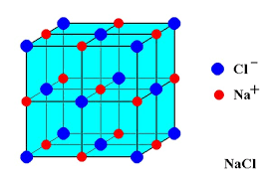
Formula Units
Formula unit - can’t separate into unique units
Ionic compounds form formula units
Always given as an empirical formula (lowest ratio)

Slide 36
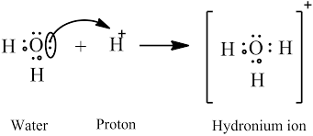
Coordinate Covalent Bond
One atom donates both electrons to form the bond
In a normal covalent bond each atom donates one electron
Shares a lone pair of electrons
Examples:

Slide 37
 | POLAR | NONPOLAR
Covalent Bond Type *What’s happening to the e- | *Unequal sharing of electrons *2 different atoms with different electronegativity | *Equal sharing of electrons *2 atoms with the same electronegativity – same element
Molecule type Distribution of charge on entire molecule | *Not symmetrical *Positive(+) and negative (-) ends | *Symmetrical *Even distribution of charge

Slide 38
Practice
1. Determine bond type (polar covalent/nonpolar covalent/Ionic)
2. Draw Lewis dot structure
CH₄
Na₂O
H₂O
MgCl₂

Slide 39
Determining Bond Type by Electronegativity Difference
Eneg difference | Bond type | Why
O - .4 | Nonpolar Covalent | Equal sharing of electrons
0 – 1.7 | Polar Covalent | Unequal sharing of electrons
1.7 or more | Ionic | Transfer of electrons

Slide 40
Covalent vs Ionic Character
4.0 - .7 = 3.3 3.3/2 = 1.7
1.7
3.3
0
Increasing covalent
Increasing Ionic
Polar Covalent
Ionic
Nonpolar
covalent
50% ionic Character/50% covalent character
Greater Electronegativity difference = greater ionic character
Greater polarity and more polar bond

Slide 41
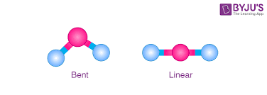
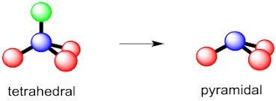
Molecular Shape

Slide 42
Linear
2 or 3 atoms
No central atom OR double bonds
May be polar OR nonpolar molecules
Examples: CO2 , HBr

Slide 43
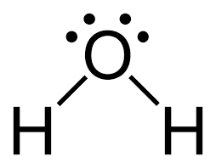
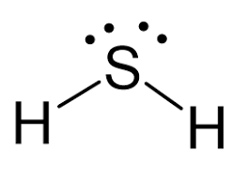
Bent
3 atoms
2 lone pairs
Polar molecules
Examples H₂O ,H₂S

Slide 44
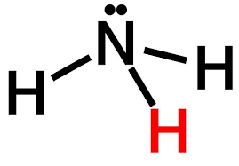
Pyramid
4 atoms
1 lone pair
Polar
Example – NH₃ (ammonia)

Slide 45
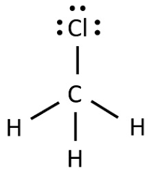
Tetrahedral
5 atoms
0 lone pairs
May be polar or nonpolar molecules
Examples CH₄, CH₃Cl

Slide 46
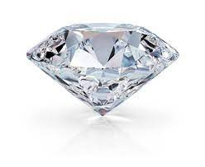
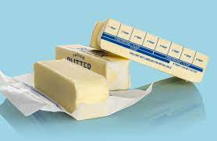
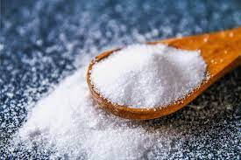
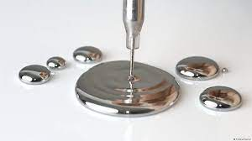
Types of Substances

Slide 47
Molecular Substances
Covalent Bonds
May be any phase at room temperature
Low melting points
Soft and Brittle
Poor conductors of heat and electricity
Examples: Butter, CO₂, Water

Slide 48
Network Substances
Covalent Bonds – many atoms covalently bonded to make a large crystal (called Macromolecule)
Solids at room temperature
Very Strong – High Boiling and Melting points
Brittle
Nonconductors of heat and electricity
Properties due to the number of bonds, not the bond type
Examples: Diamond, SiC, SiO₂ (quartz)

Slide 49
Ionic Substances (crystals)
Ionic Bonds
Crystal lattice structure
Brittle
High melting points
Conduct electricity when liquid or dissolved in water (aqueous) – DO NOT conduct as solids.
Example: table salt or any other ionic compound

Slide 50
Metallic Substance
Metallic bonds
Variable melting points
Luster (shiny)
Malleable and ductile
Good conductors of both heat and electricity in both the solid and liquid phase
Examples: Cu, Fe, Hg

Slide 51
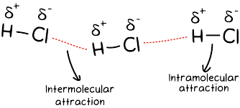
Intermolecular Forces
Atoms are held together to make molecules by chemical bonds – Covalent/Ionic/Molecular
These are intra-molecular forces – they involve valence electrons
Molecules must be held together to make solids and liquids – THESE ARE INTER-MOLECULAR FORCES

Slide 52
Strong inter-molecular forces require lots of energy to overcome the attraction, to allow them to melt or boil.
Energy must be used to pull the molecules farther apart
Strong intermolecular forces = high melting and boiling points
Four main types

Slide 53
1. Dipole – Dipole Attraction
Polar molecules attract each other due to +/-charged ends (poles)
Example: HCl

Slide 54
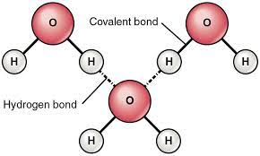
Hydrogen Bonds
Very strong dipole – dipole attraction
Happens when Hydrogen is bonded to N, O or F
Small atoms with high electronegativity
Very polar molecules
Strongest intermolecular force
Accounts for the high BP of water compared to H₂S or alcohol
Examples: NH₃, H₂O, HF

Slide 55
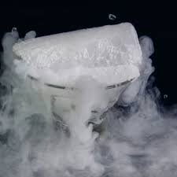
Van Der Waals Force
Weak attraction between nonpolar (symmetrical) molecules
Momentary or induced dipole effect (e- out of balance)
Allows for nonpolar molecules to form liquids or solids
Example: solid CO₂ – dry ice
Larger molecules = stronger Van Der Waals Force (higher BP/MP)

Slide 56
Molecule/Ion Attraction
Polar molecules pull apart ionic crystals
The ionic crystal dissociates (comes apart)
Polar solvents (water) dissolve ionic substances – Like Dissolves Like.
NaCl_{(s)} → Na⁺_{(aq)} + Cl⁻_{(aq)}

Slide 57
Summary
Larger molecules = stronger force
More polar molecules = stronger force
Stronger force = higher melting and boiling points
Responsible for phase change
Hydrogen Bonding (strongest)
Dipole – dipole attraction
Van Der Waals Force (weakest)
Responsible for dissolving
Molecule/Ion attraction

