Slide 1
Unit 11
Acids Bases
and Salts

Slide 2
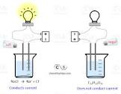
Electrolytes
Substance which dissolves in water to form a solution which conducts electricity.
The ability conduct is due to the presence of ions which are free to move in solution.
Ionic compounds (salts)
Acids (covalent) – Inorganic start with H, Organic end with COOH.
Bases (ionic) inorganic compounds that end with OH.

Slide 3
Ways to Define Acid/Base
1. Based on observed properties
2. Classical or Arrhenius definition
H⁺ and OH⁻
3. Bronstead-Lowry definition
Movement of H⁺ (protons)

Slide 4
Operational Definition (Based on Properties)
1. Aqueous solutions of acids and bases conduct electricity. (electrolytes)
The ability to conduct depends on the # of free H⁺ or OH⁻ in solution

Slide 5
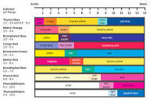
2. Cause color changes in pH indicators
Indicators do not change color at exactly pH 7. They change over a range of pH called the transition interval.
Table M shows the color change and transition interval for several indicators.

Slide 6
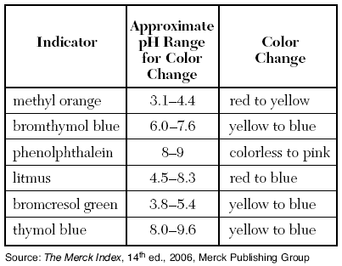

Slide 7
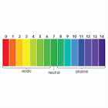
Universal indicator
Many indicators are combined in a single solution, goes through several color changes at different intervals.

Slide 8
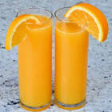
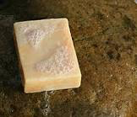
3. Dilute solutions of acids taste sour, dilute solutions of bases taste bitter.
Bases feel slippery.

Slide 9
4. Acids react with some metals in a single replacement reaction to release H₂ gas.
Acids will react with those metals that are more active than H₂ according to table J.
Any metal above H² in table J is more active than H₂, and will replace H₂ in a single replacement reaction.
Example:
HCl + Mg → MgCl₂ + H₂ –> reacts, Mg is above H₂
HCl + Cu → No reaction Cu is below H₂

Slide 10
5. Acids react with bases in a double replacement reaction to form a salt and water
H⁺ + OH⁻ → H₂0 – called neutralization
Acid + Base → Salt + Water
HCl + NaOH → HOH + NaCl

Slide 11
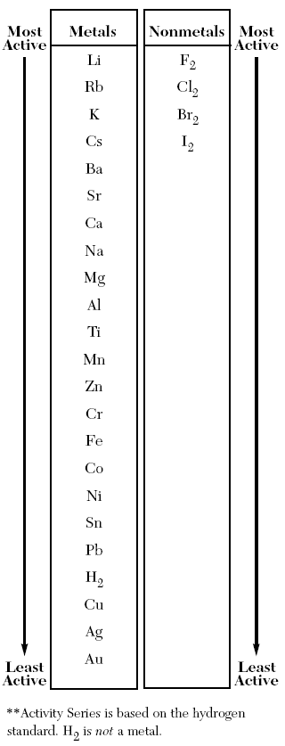

Slide 12
Classical or Arrhenius Definition
Acid → any substance which donates H⁺ (hydrogen ions) as the only positive (+) ion in solution.
Inorganic – starts with H
Organic – ends with COOH
Base → any substance which donates OH⁻ (hydroxide ions) as the only negative (-) ion in solution.
Inorganic – ends with OH
Organic –ends with OH = Alcohol

Slide 13
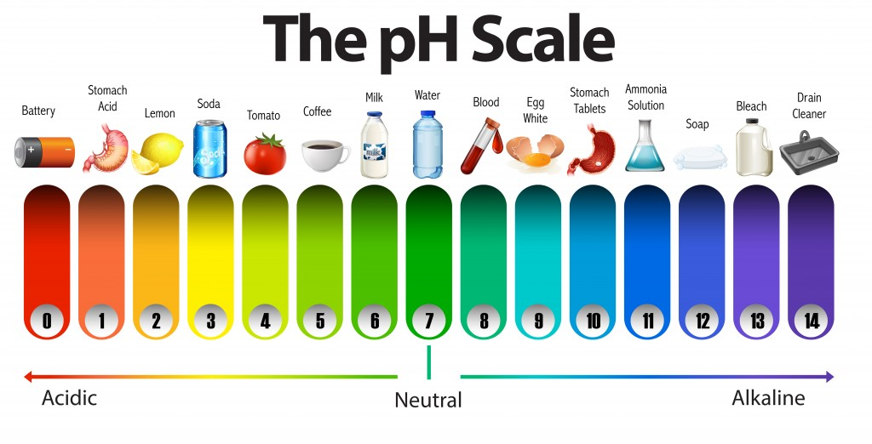
An acidic substance has more H⁺ than OH^{-.}
A basic substance has more OH⁻ than H⁺
If the H⁺ = OH⁻ the solution is neutral

Slide 14
pH Scale
pH expresses the H⁺ concentration [H⁺]
H⁺+ H₂O → H₃O⁺ (H⁺ = H₃O⁺)
pH = log 1/[H⁺] or pH = -log [H⁺]
In pure water, some of the molecules are ionized (pulled apart)
**[ ] should be read as concentration of

Slide 15
pH | [H+] X [OH-] = 1X10 ⁻¹⁴ | pOH
1 | 1 X 10⁻¹ X 1 X 10⁻¹³ = 1X10 ⁻¹⁴ | 13
2 | 1 X 10⁻² X 1 X 10⁻¹² = 1X10 ⁻¹⁴ | 12
? | 1X 10 ⁻⁵ X ? = 1X10 ⁻¹⁴ | ?
? | ? X ? = 1X10 ⁻¹⁴ | 4
? | ? X 1X10⁻¹ = 1X10 ⁻¹⁴ | ?

Slide 16
Each whole # on the pH scale represents a 10X increase (or decrease) in the # of H+ ions, and therefore the acidity of the solution.
[H+]>[OH-] [H+]<[OH-]
1 2 3 4 5 6 7 8 9 10 11 12 13 14
Increasing acid increasing basic
neutral
[H+] = [OH-]

Slide 17
Example
pH 5 is 10X more acidic than pH 6, 100X more acidic than pH 7 and 1000X more acidic than pH 8.
Remember each number is ten times different.

Slide 18
Problems
What is the [OH⁻] concentration in a solution with a pH of 4?
What is the pH of a .001M solution of HCl?
What is the pH of a .1M solution of NaOH?

Slide 19
Bronstead-Lowry Theory
Acid – any species (molecule or ion) that can donate a proton (H⁺) to another species a proton donor
Base – any species which can accept (or combine with) a proton (H+) a proton acceptor

Slide 20
When an acid donates it’s proton it becomes it’s Bronstead-Lowry conjugate base
When a base accepts a proton, it becomes it’s Bronstead-Lowry conjugate acid
Amphiprotic/amphoteric – can act as either an acid or a base depending on what it’s combined with.

Slide 21
Examples
H₂O + HCl
H₂SO4 + H₂O
NH₃ + H₂O
H₂O + H₂O

Slide 22
Titration
A laboratory procedure which allows you to determine the concentration of a known volume of acid or base by neutralizing it with a known concentration and volume of acid or base.
Molarity_{acid} X Volume_{acid} = Molarity_{base} X Volume_{base}
M_{A} X V_{A} = M_{B} X V_{B}

Slide 23
Problems
How many mL of .5M NaOH are required to completely neutralize 50 mL of .2M HCl?
If 50 mL of .5 M HCl are used to neutralize 25 mL of KOH, what is the concentration of the KOH?

Slide 24
Acid/Base Strength
Any group 1 hydroxide is a strong base – all other bases are weak.
Table K (common acids) are listed in order of strength – top to bottom, strongest to weakest. Consider the top 5 strong and the rest weak.

Slide 25
Hydrolysis
Opposite of neutralization –
Salt + water → acid + Base
*Neutralization – Acid + base → salt + water
To predict pH of a salt solution, look at relative strength of the parent acid and parent base.
If both are strong Ph is 7
If base is strong and acid is weak pH is >7 (basic)
If acid is strong and base is weak pH is <7 (acid)

Slide 26
Examples
NaCl + H₂O →
NH₄Cl +H₂O →
NaC₂H₃O₂ + H₂0 →
NH₄C₂H₃O₂ + H₂O →

