Slide 1
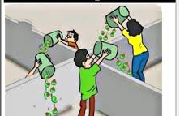
Unit 10
Kinetics and Equilibrium

Slide 2
Kinetics
The study of the rate and mechanism of a chemical reaction.
Rate: How fast (measured in moles of product formed, or reactant used per unit time.)
Mechanism: Steps in a reaction

Slide 3
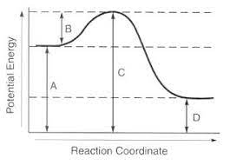
ReactionDiagrams
Graph of potential energy (Y axis) against time or reaction coordinate (X axis).

Slide 4
Enthalpy (H)
Heat content or PE of a substance (H)
Enthalpy change: (heat of reaction or H)
Difference in PE of products and
H = H_{product} - H_{reactant}
Activation energy – minimum energy needed to start the reaction. - amount of energy needed to reach the activated complex

Slide 5
Exothermic – energy is released, products have less PE than reactants
H is negative (-)
Endothermic- energy is absorbed, products have more PE than reactants.
H is positive (+)
Reference table I gives H values for example reactions.

Slide 6
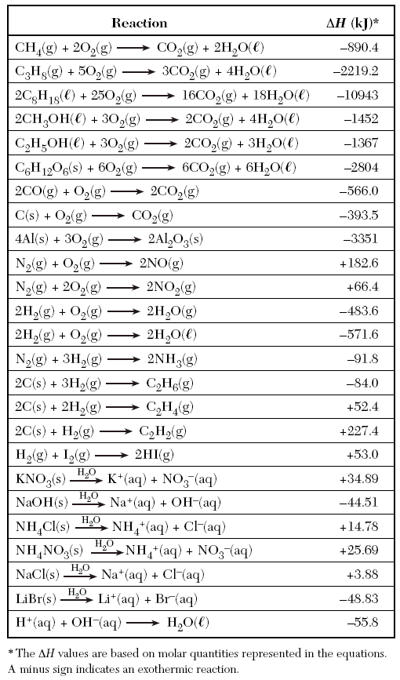

Slide 7
The energy amount from table I can be included in the chemical equation oas either a product ( H - , exothermic) or as a reactant ( H +, endothermic).
EX:
2H₂ + O₂ → 2H₂O + 571.6 kj
H = -571.6 kj
H₂ +I₂ + 53.0 kj → 2HI
H = + 53.0 kj

Slide 8
DO NOT confuse the position of energy in the equation with the sign of H! When H is negative, it is added to the products side of the equation.

Slide 9
Collision Theory
The rate of a reaction depends on the number of effective collisions between particles.
Effective Collision – one which produces product
Must have → enough energy and proper orientation.

Slide 10
Factors which effect Rate
Types of Bonds:
Ionics in solution react very fast – bonds don’t need to be broken (dissociate)
Covalents react slowly at room temperature –bonds must be broken before atoms can rearrange

Slide 11
Concentration:
Concentration = Collisions = Rate
Rate means Time
*add more particles or decrease volume.
For Gasses
Pressure = Volume = Concentration

Slide 12
Temperature:
An increase in temperature causes an increase in BOTH the number and the effectiveness of collisions.

Slide 13
Surface Area:
Surface Area = Collisions
Breaking substance into smaller pieces increases surface area.

Slide 14
Catalyst:
Speeds up reaction by lowering activation energy.
Provides an alternate pathway for the reaction.
Remains unhanged in the reaction – not part of products or reactants.

Slide 15
Effect of a Catalyst

Slide 16
Entropy (S)
Measure of a systems rendomness or disorder.
How messy is it?
The bigger the mess, the greater the entropy.
S = S_{products} – S_{reactants}
a negative (-) S = a decrease in entropy (more organized)
A positive (+) S = an increase in entropy (more random

Slide 17
Factors which effect Entropy
Phase change:
Solids have the lowest entropy –gas has the highest entropy.
+ S
More organized → More random
H₂O_{(s)} H₂O_{(g)}
- S

Slide 18
Temperature:
Increased temperature = increased entropy
+ S

Slide 19
Decomposition reactions:
Individual elements are more random than compounds.
+ S
More organized → More random
H₂O H₂ + O₂
- S

Slide 20
Spontaneous Reactions
Reactions occur (or fail to occur) based on two natural tendencies:
1. Enthalpy change ( H)
2. Entropy change ( S)

Slide 21
Enthalpy Change
Drive toward greater stability (lower potential energy)
Exothermic reactions are favored.
- H favorable – exothermic
+ H unfavorable - endothermic

Slide 22
Entropy Change
Drive toward less organization (higher entropy)
+ S – favorable ( increased entropy)
- S – unfavorable ( decreased entropy)

Slide 23
If both conditions are favorable – reaction is spontaneous
H - (exothermic), S + (more random)
If both conditions are unfavorable, reaction is not spontaneous
H + (endothermic), S - (more organized)

Slide 24
If one condition is favorable, and one is unfavorable, temperature determines if the reaction will occur.
H₂O_{(s)} → H₂O_{(l)}
H ______, S ________

Slide 25
Equilibrium
State of balance between two opposing reactions.
The forward and reverse reaction occur at the same rate.
***This does not mean the amount of product and reactant are equal.
It means the amount of product and reactant will remain constant.

Slide 26
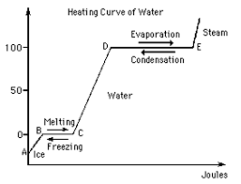
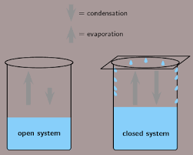
3 Types of Equilibrium
Phase Equilibrium
At 0º rate of melting = rate of freezing
And/or
At 100º rate of vaporization = rate of condensation

Slide 27
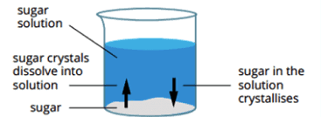
Solution Equilibrium:
Rate of dissolving = rate of recrystillization.
NaCl_{(s)} Na⁺_{(aq)} + Cl⁻_{(aq)}
A saturated solution is always at equilibrium

Slide 28
Chemical Equilibrium:
The rate of the forward reaction = the rate of the back reaction.
N₂ + 3H₂ 2NH₃ (Haber Process)

Slide 29
Time | reactants | products
0 | 100% | 0%
5
10
15
20
25
30
35

Slide 30
LeChatlier’s Principle
When a system at equilibrium is subjected to stress, it will shift its position (change concentrations) to relieve the stress.
Equilibrium is reestablished at a new set of concentrations.
ALWAYS SHIFT AWAY FROM AN INCREASE
ALWAYS SHIFT TOWARD A DECREASE!

Slide 31
Ways to stress the system
A. Effect of Concentration:
Increasing the concentration of any substance in a reaction causes the system to shift in the direction that consumes the increase.

Slide 32
Examples:
N₂ + 3H₂ 2NH₃
Stress; Add N₂
Problem – too much Nitrogen
Solution – get rid of nitrogen
How? - make more NH₃
Result? – equilibrium shift toward the right (away from the increase) products are favored. (NH₃) , (H₂)

Slide 33
N₂ + 3H₂ 2NH₃
Stress; Add NH₃
Problem – too much ammonia
Solution – get rid of ammonia
How? - break down NH₃ to N₂ and H₂
Result? – equilibrium shift toward the left (away from the increase) reactants are favored. (N₂) , (H₂)

Slide 34
N₂ + 3H₂ 2NH₃
Stress; remove NH₃
Problem – too little ammonia
Solution – make more ammonia
How? - combine N₂ and H₂ to form NH₃
Result? – equilibrium shift toward the right (toward the decrease) products are favored. (N₂) , (H₂) , (NH₃)

Slide 35
Several ways to remove product from a reaction ( and decrease its concentration)
1. formation of a gas which is allowed to escape.
2. Formation of a precipitate
3. formation of an un-ionized product (such as water) from an ionic reaction
Removal of product drives the forward reaction to completion (all product/no reactant)

Slide 36
B. Effect of Pressure
Pressure only effects systems which involve gasses!
Increasing pressure will push the equilibrium point to the side with the fewest moles.
Gasses need space to move around – fewer moles take up less space.

Slide 37
Examples
N_{2(g)} + 3H_{2(g)} 2NH_{3(g)}
Stress; increase pressure
Problem – not enough space
Solution – take up less space
How? - combine 4 moles into 2 moles
Result? – equilibrium shift toward the right products are favored.
(N₂) , (H₂), (NH₃)

Slide 38
Cl₂ + H₂ 2HCl
Stress; increase pressure
Problem – not enough space
Solution – take up less space
How? - can’t be done – both sides have 2 moles
Result? – no effect on equilibrium since the same # of moles on both sides of the reaction.

Slide 39
C. Effect of Temperature (energy/heat):
Increasing temperature will shift the reaction in the direction that absorbs heat (favors the endothermic reaction)
All reaction rates are increased by aan increase in temp, however, the rate of the endothermic reaction increases more than the exothermic reaction.

Slide 40
Example
CO_{(g)} + ½ O_{2(g)} CO_{2(g)} + 67.7 kj
Stress; increase temperature
Problem – too much heat (energy)
Solution – use up or get rid of heat
How? - use energy in the endothermic rxn.
Result? – endothermic reaction is favored. Equilibrium shift toward the left, reactants are favored.
(CO) , (O₂) , (CO₂)

Slide 41
D. Effect of a Catalyst:
A catalyst increases the rate of BOTH the forward and back reaction equally.
A catalyst does NOT effect the concentrations of products or reactants at equilibrium (the equilibrium point)
A catalyst may cause equilibrium to be reached sooner.

Slide 42
E. Common Ion Effect:
Adding a common ion increases the concentration of that ion in the reaction.

Slide 43
Example
KNO_{3(s)} K⁺_{(aq)} + NO₃⁻_{(aq)}
Stress; add NaNO₃
(NaNO_{3(s)} Na⁺_{(aq)} + NO₃⁻_{(aq)})
Problem – too much NO₃⁻
Solution – use up or get rid of NO₃⁻
How? - recrystallize KNO_{3(s)}.
Result? –Equilibrium shift toward the left, reactants are favored. *decreases the solubility of the salt.

Slide 44
Problems
CaCO_{3(s)} + 22 kj CaO_{(s)} + CO_{2(g)}
Which direction will the equilibrium shift?
Temperature is increased?
Temperature is decreased?
Pressure is increased?
Pressure is decreased?
Solid CaCO₃ is added?
CO_{2(g)} is added?

Slide 45
SbCl_{5(g)} + 19.3 kj SbCl_{3(g)} = Cl2_{(g)}
Which direction will the equilibrium shift?
Temperature is increased?
Temperature is decreased?
Pressure is increased?
Pressure is decreased?
Removing SbCl₅?
Cl_{2(g)} is added?

