Slide 1
Unit 8
Solids liquids and Gasses

Slide 2
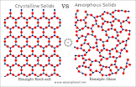
Properties of Phases
Solids:
High density – particles are packed closely together
Definite shape
Definite volume
May be crystalline or amorphous

Slide 3
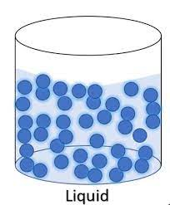
Liquids:
Lower density than solids, but greater density than gas
Indefinite shape – particles can move or change position relative to each other
Takes the shape of its container
Definite volume – not easily compressed

Slide 4
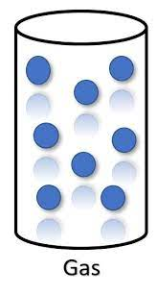
Gasses:
Low density – particles far apart
Indefinite shape
Indefinite volume
Will expand to fill container
**In order for a substance to change phase you must overcome the intermolecular forces.

Slide 5
Heating and Cooling Curve
Vaporization/
Evaporizaton
gas
Temperature
Condensation
liquid
Melting/fusion
freezing
solid
Time (addition of energy at constant rate)

Slide 6
Definitions
Fusion – same as melting
Heat of Fusion (H_{f})– amount of energy needed to melt a solid at its melting point.
For water – 334 joules/gram
Heat of Vaporization (H_{v})- amount of energy needed to vaporize a liquid at its boiling point.
For water – 2260 joules/gram

Slide 7
Specific heat (C): Amount of energy needed to raise the temperature of 1 gram of a substance 1^{O} C.
For water – 4.18 joules/gram/degree C.

Slide 8
Example Problem
How much energy is needed to raise the temperature of 5 grams of ice from -3ºC to 103º C?

Slide 9
H₂O_{(s)} at -3º → H₂O_{(s)} at 0º
Q= mcΔt Q = (5)(4.18)(3) = 62.7 j
H₂O_{(s)} at 0º → H₂O_{(l)} at 0º
Q = mH_{f} Q =(5)(334) = 1670j
H₂O_{(l)} at 0º → H₂O_{(l)} at 100º
Q= mcΔ t Q = (5)(4.18)(100) = 2090 j
H₂O_{(l)} at 100º → H₂O_{(g)} at 100º
Q = mH_{v} Q =(5)(2260) = 11,300j
H₂O_{(g)} at 100º → H₂O_{(g)} at 103º
Q= mcΔt Q = (5)(4.18)(3) = 62.7 j
Total = 15,185.4 j

Slide 10
Examples
1. How many grams of water can be heated from 10º to 50º by the addition of 400 j?
2. How much energy is needed to raise the temperature of 10 grams of water from 15º to 30º?

Slide 11
In order to cause a phase change, energy must either be added or removed from a substance. (heat of fusion/heat of vaporization)
This energy is used to overcome intermolecular forces

Slide 12
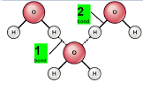
Intermolecular vs Intramolecular
Intramolecular – involves electrons – holds 2 atoms together to make a molecule
Intermolecular – holds molecules together to form solids and liquids

Slide 13
Intermolecular forces
Ionic Crystal
molecule/ion attraction
Polar molecules
Van der Waals forces
Nonpolar molecules
Dipole/
Dippse
Attration
Hydrogen
bonds

Slide 14
Definitions
Melting/freezing point: Temperature at which solid changes to liquid.
Boiling Point: Temperature at which liquid changes to gas.
Normal BP – measured at standard pressure – 101.3 KPa or 1 atm.
The temperature at which the vapor pressure is equal to the atmospheric pressure.

Slide 15
Vapor Pressure: Pressure caused by gas molecules changing to vapor.
If you increase the atmospheric pressure, the temperature at which the substance boils increases.
Table H gives the vapor pressure of 4 liquids at different temperatures – use to find boiling point.

Slide 16
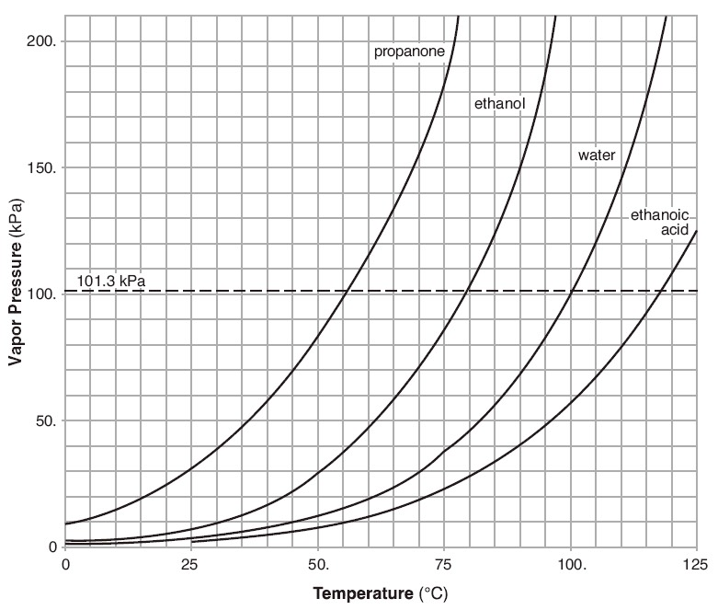

Slide 17
Vaporization: phase change of a substance from liquid to gas – when the substance is at it’s boiling point.
Boiling happens throughout the liquid
Evaporation: Phase change of a substance from liquid to gas – for a substance below it’s boiling point.
Evaporation happens only at the surface.

Slide 18
Factors which effect evaporation rate
Surface Area
Temperature
Air Currents/Air Movement – carries vapor molecules away
Evaporative Cooling – As high kinetic energy molecules escape, KE , therefore temp .
Pressure
Strength of intermolecular forces

Slide 19
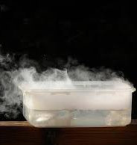
Sublimation
Change directly from solid to gas – no liquid phase.
Molecules have high vapor pressure and weak intermolecular forces.
Examples:
Dry ice (CO_{2(s)})
Iodine (I_{2(s)})
Napthaline (moth balls)

Slide 22
Scientific theory
An explanation of observations – explains how something occurs

Slide 23
Kinetic Molecular Theory
Explains how gasses behave
All matter consists of tiny particles (atoms/molecules) in constant motion.
Size of particles are negligible compared to the distance between them – considered to have 0 volume.
Particles are so far apart they have no attraction for each other ( no IMF)
Particles are in constant random straight line motion.

Slide 24
Ideal Gas
Behave as predicted by Kinetic Theory – can exactly predict Volumes/Temperature/ Pressure.
Follow gas laws exactly.
The particles have 0 volume and 0 attractive forces.

Slide 25
Real Gas
Deviates from predictions of kinetic theory (the particles have volume and attract each other).
There are NO IDEAL GASSES, however, most behave close to ideal under most conditions of pressure and temperature.
Gas laws predict volume, pressure, temperature.

Slide 26
Most like Ideal:
High temperature
Low pressure
Small molecules (H₂)
Least like Ideal: (most real)
Low temperature
High Pressure
Small Molecules

Slide 27
Deviations From Ideal
Very low temperature – volume will be less than predicted
High pressure – volume will be greater than predicted

Slide 28
Behavior of Gasses
Pressure – Result of gas molecules hitting a surface.
Units: Atm., mmHg, Torr, Kpa.
Standard Pressure – 1 Atm = 760 mmHg = 760 Torr = 101.3 Kpa.
Examples:
1. 200 Kpa = ? mmHg
2. 4 atm = ? Kpa
3. 550 mmHg = ? Atm.

Slide 29
Boyles Law
Pressure | Volume | Pressure X Volume
1 Atm. | 800 mL | 800
2 Atm. | 400 mL | 800
3 Atm. | 267 mL | 800
4 Atm. | 200 mL | 800
6 Atm. | ? | ?
P₁V₁ = P₂V₂

Slide 30
Boyles Law Graph
Volume
Pressure

Slide 31
Problems
You have 20 mL of gas at 101.3 Kpa. If the pressure is increased to 150.0 Kpa, what is the new volume?
P₁V₁ = P₂V₂

Slide 32
Charles Law
V₁/T₁ = V₂/T₂
Temp C | volume | Volume /Temp C | Temp K | Volume /temp K
10⁰ | 100 mL
50⁰ | 114 mL
100⁰ | 132 mL
200⁰ | 167 mL
300⁰ | ??

Slide 33
Charles Law Graph
Volume
Temperatiure

Slide 34
Problem
!00 mL of agas at 20⁰ C would expand to what volume at 40⁰C?
V₁/T₁ = V₂/T₂

Slide 35
Gas Laws
Boyles Law: At constant temperature the volume of a sample of gas is inversely proportional to the pressure exerted on the gas.
P x V = Constant
P₁V₁ = P₂V₂

Slide 36
Charles Law: At constant pressure the volume of a sample of gas is directly proportional to the kelvin temperature.
V/T = constant
V₁/T₁ = V₂/T₂

Slide 37
Combined Gas Law: (table T)
P₁V₁/T₁ = P₂V₂/T₂
Problem: 30mL of gas at STP is heated to 30⁰C and placed in a container under 3 atm. Pressure. What volume must the container have?

Slide 38
Avogadro’s Hypothesis
Equal volumes of different gasses at the same temperature and pressure contain the same number of molecules (same number of moles).
He
NH3
O₂
CO2

Slide 39
Avogadro’s Law
1 mole of molecules takes up 22.4 liters of space at STP.
22.4 L = the molar volume.
Volume is directly proportional to the number of moles.
V₁/n₁ = V₂/n₂
**n = number of moles

Slide 40
Grahm’s Law of Diffusion
**Assuming the same temperature and pressure – the rate of diffusion of a gas is inversely proportional to the square root of the mass of it’s particles.
OR – the bigger it is, the slower it moves!
Mass (or density) Rate

Slide 41
HCl NH₃
1 + 35 = 36 14 + 3 = 17
A
B
C
HCl
NH₃

Slide 42
Dalton’s law of Partial Pressure
For any mixture of gasses in a container, the total pressure exerted is the sum of the pressure each would exert alone.
P_{total} = P₁ + P₂ +P₃

Slide 43
Each gas exerts pressure according to it’s mole ratio:
If the total pressure in the above container = 30 atm., what is the partial pressure of each gas?
Let X = pressure of one mole…..
2X + 3X + 5X = 30 atm. 10X = 30 atm.
X = 3 atm.
He = 6 atm, H₂ = 9 atm, NH₃ = 15 atm
2He 3H₂ 5NH₃

Slide 44
A mixture of gasses is 78% N₂ and 22% O₂. The total pressure is 1.12 atm. What are the partial pressures of each gas?
P_{N2} -- 1.12 X .78 = .87 atm.
P_{O2} –1.12 X .22 = .25 atm.

